Slide 1
Project 1
Household final consumption expenditure
By: Group 9.
Kevin Wan
Penyaree Werning
Xhulio Zhapa
Ninad Pandya

Slide 2
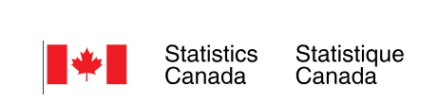
Items of Household final consumption expenditure, Canada
(1961-2023)
Alcoholic beverage, tobacco and cannabis Communication Food and non-alcoholic beverage Furnishings, household equipment and other goods and services related to dwelling and property Insurance and financial services Net expenditure abroad Clothing and footwear | 8. Education 9. Food, beverage and accommodation services 10. Health 11. Housing, water, electricity, gas, and other fuels 12. Miscellaneous goods and services 13. Recreation and culture 14. Transport
Statistics Canada. Table 36-10-0107-01 Household final consumption expenditure, quarterly, Canada (x 1,000,000)
DOI: https://doi.org/10.25318/3610010701-eng

Slide 3
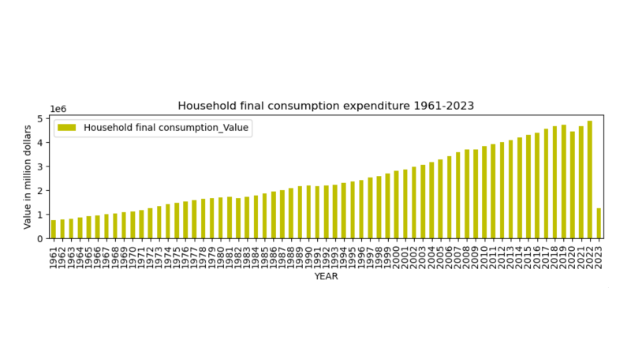
Overall
Overall Growing Household Expenditures, 1961-2023

Slide 4
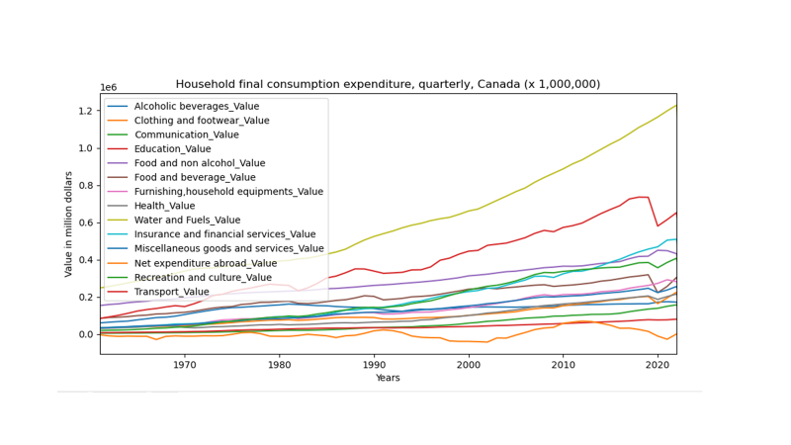
Detail of Overall Household Expenditures, 1961-2022

Slide 5
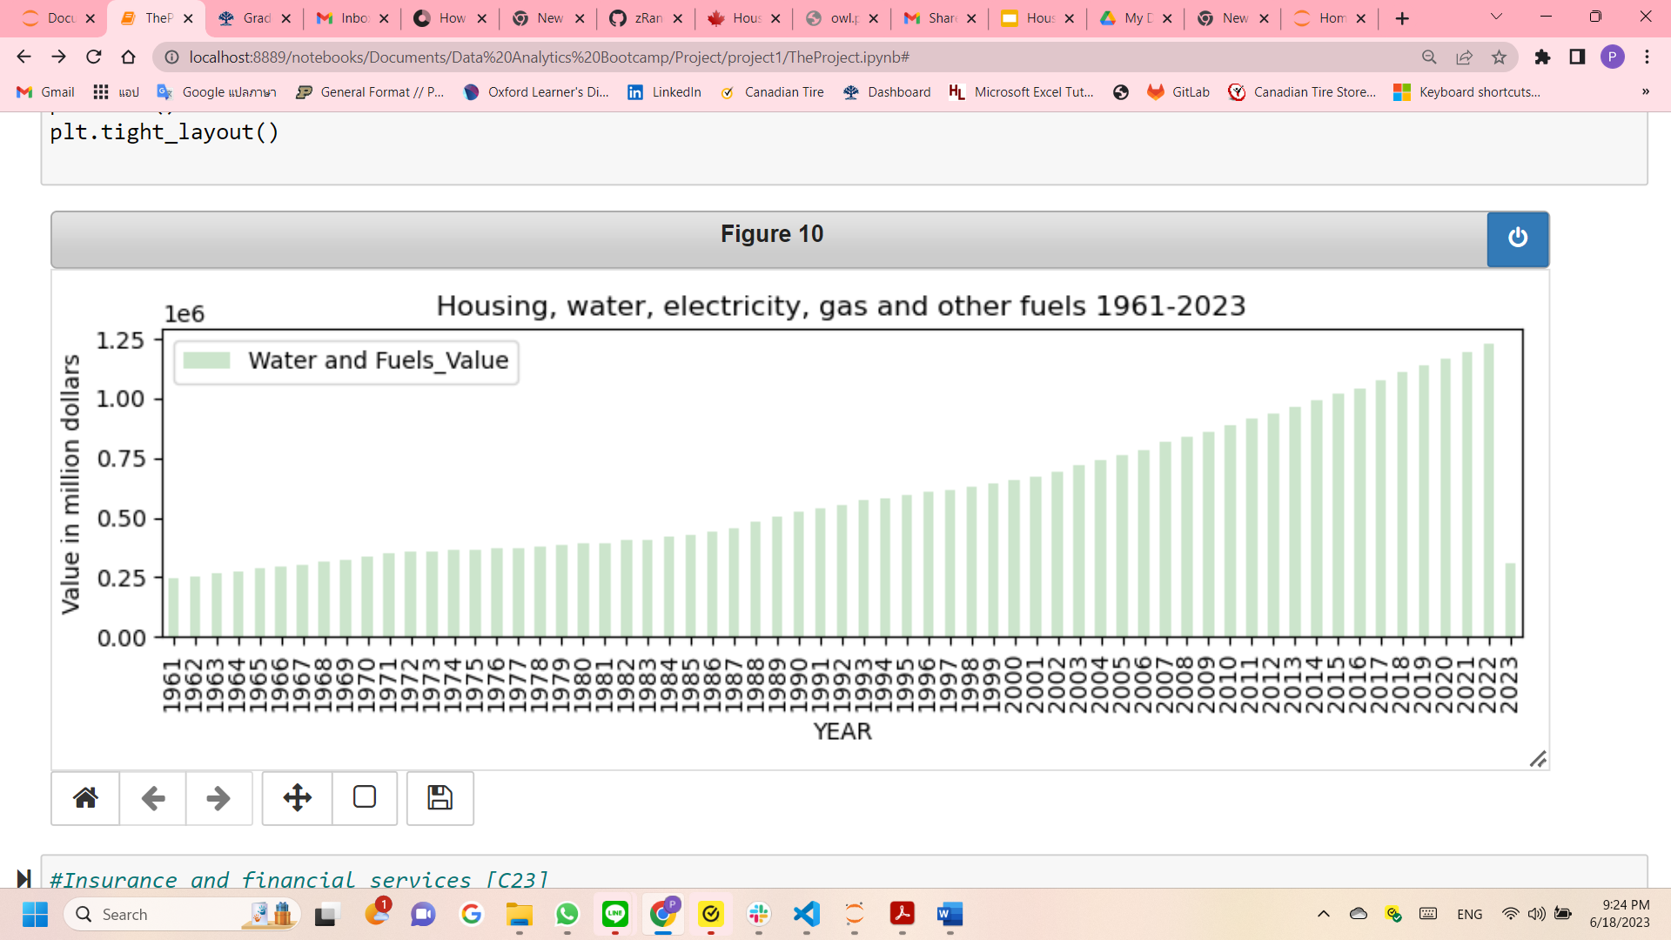
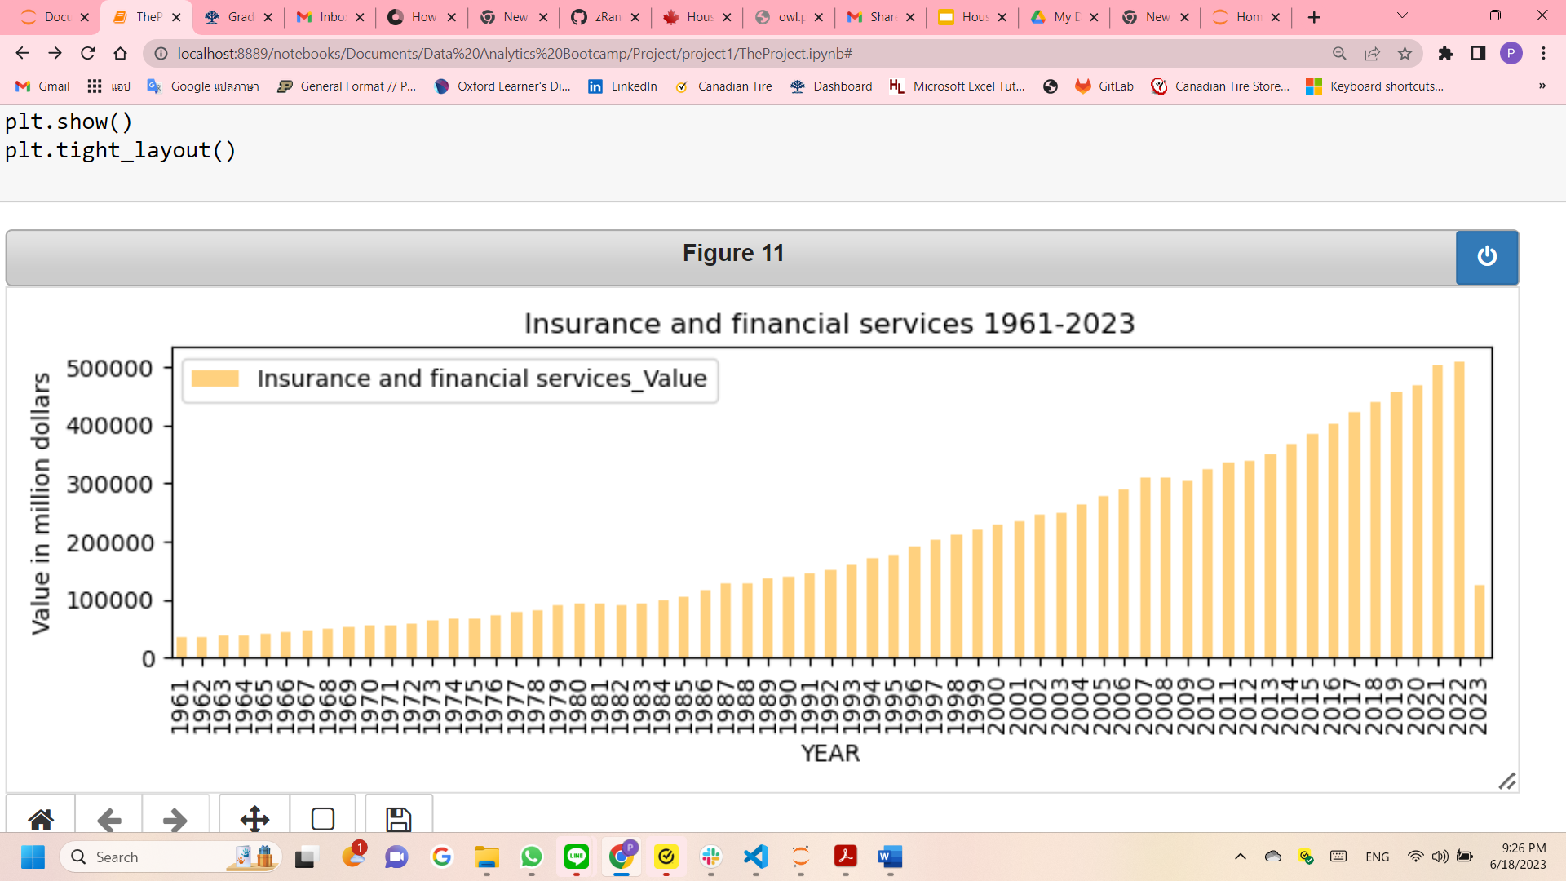
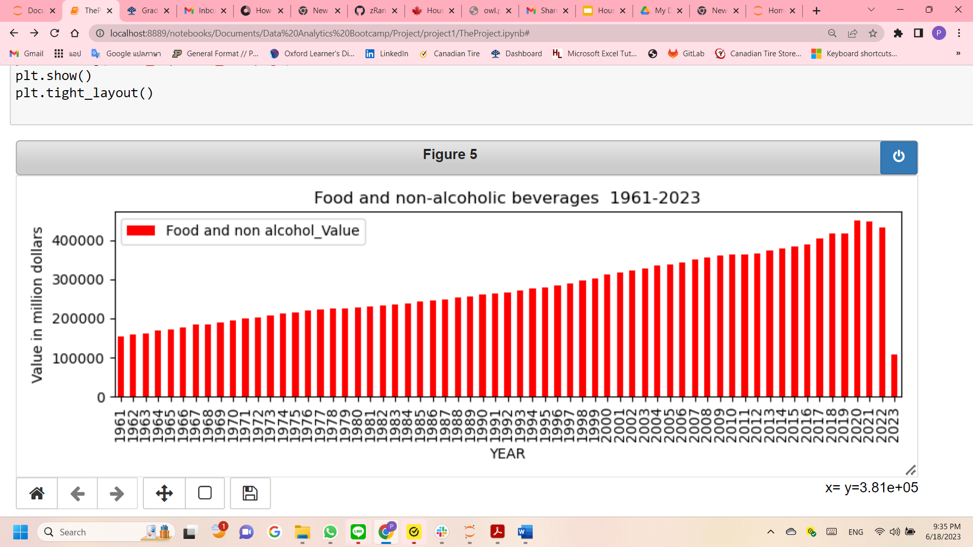
Highest expenditure growth
Housing, water, electricity, gas and other fuels
Insurance and financial services
Food and non alcohol beverage

Slide 6
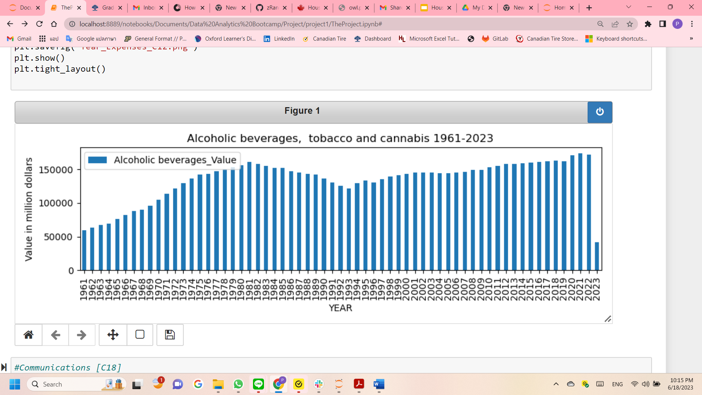
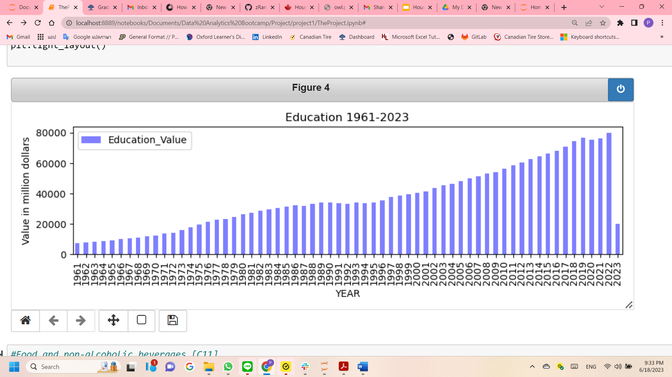
Steady expenditure growth
Alcoholic beverages, tobacco and cannabis
Education
Communication
Furnishings, household equipment and other goods and services related to the dwelling and property

Slide 7
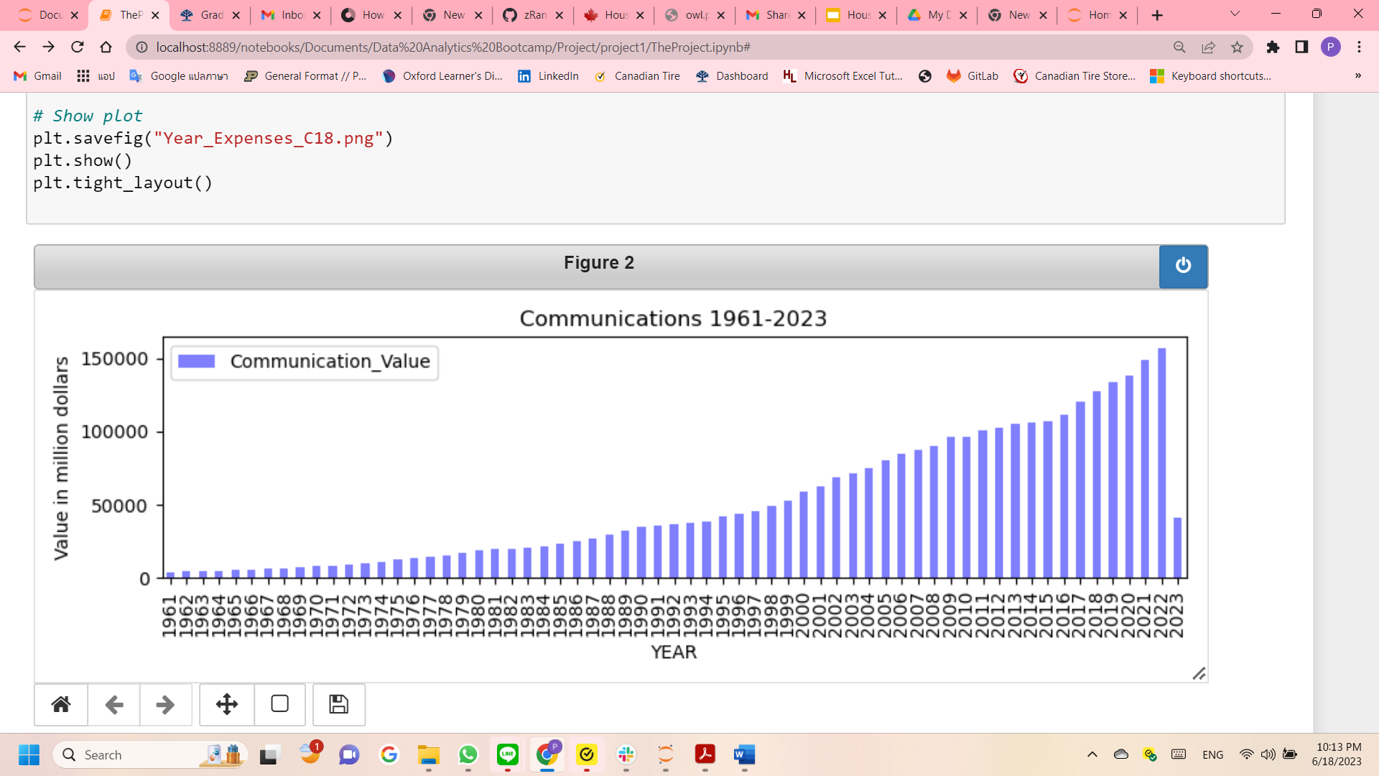
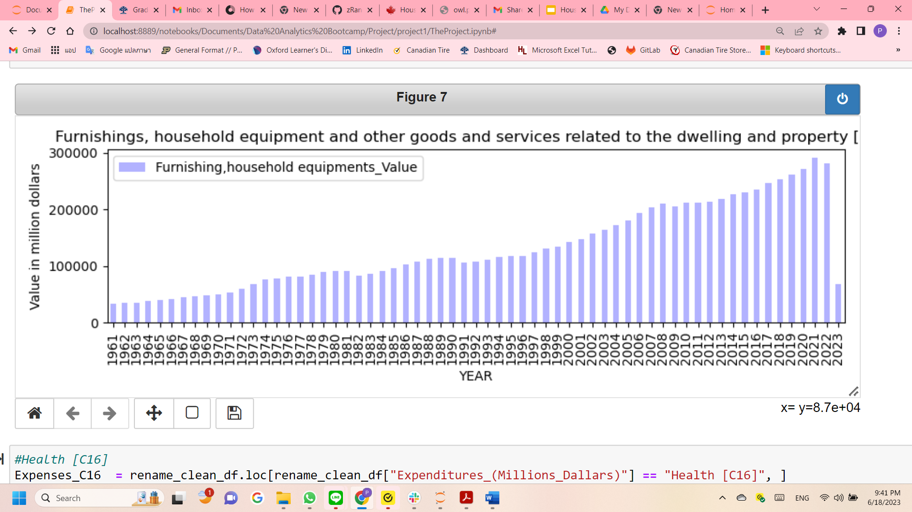
Steady expenditure growth (Cont.)

Slide 8
What is Chain-Weighted CPI?
This data set uses chain-weighted CPI
Chain-weighted CPI takes real-word purchasing decisions into account to provide a more accurate picture of the cost of living.
Chain-weighted CPI can capture both general changes in spending, as consumer preferences change, and substitution effects, when relative prices change.
The adjustments in chain-weighted CPI make it a better measure of the cost of living, but a less accurate measure of inflation.

Slide 9
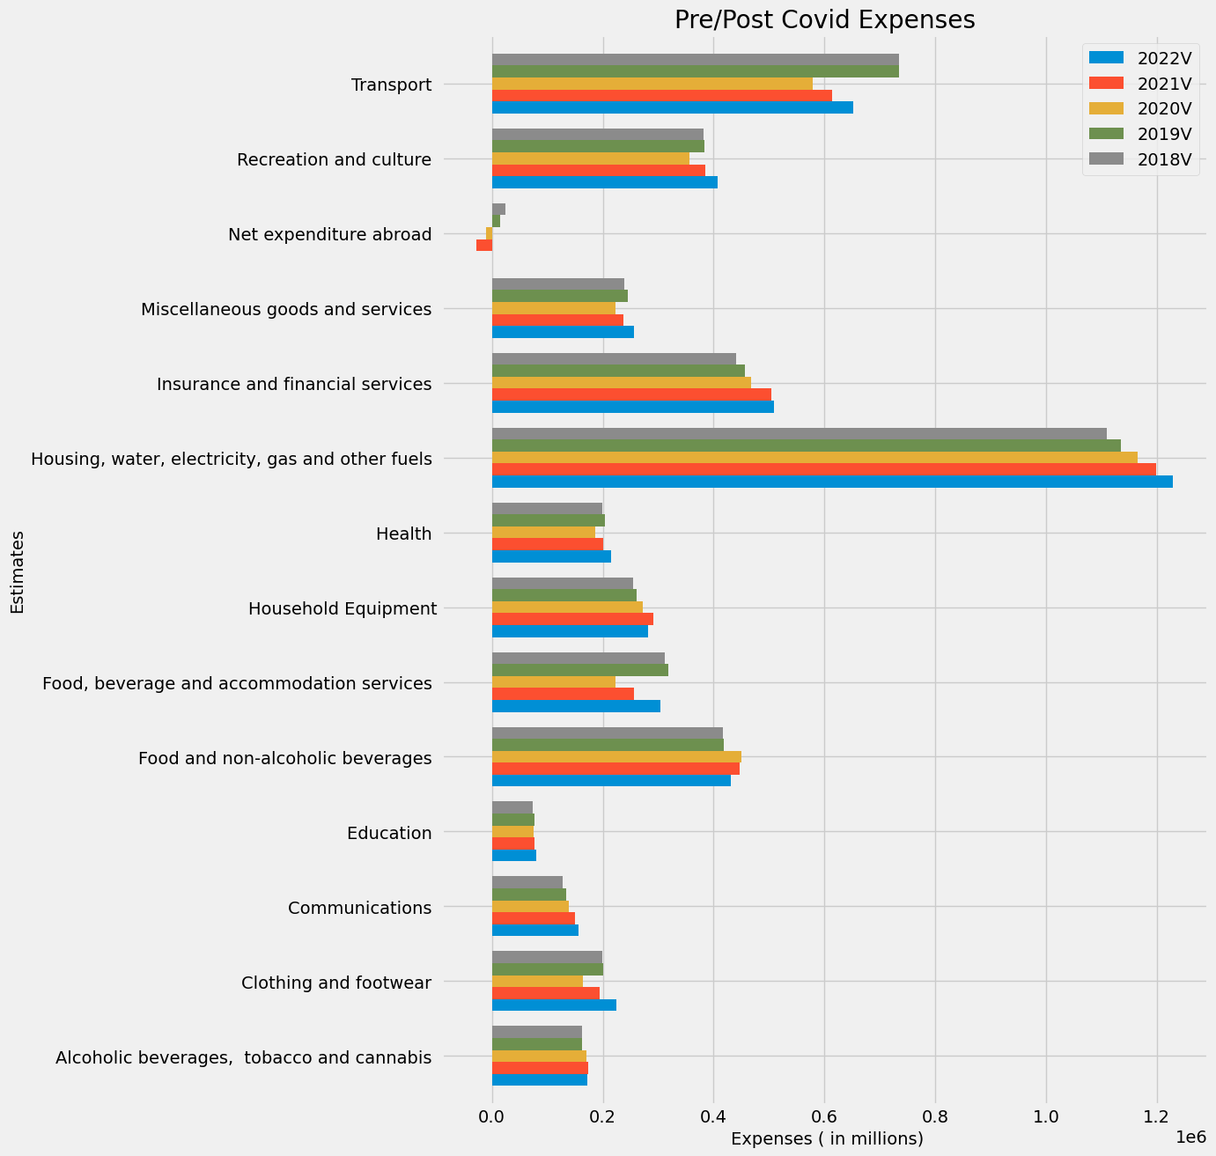
Covid- PoI
Transport
Net expenditure Abroad
Health (Medical products, Services)
Household Equipment( Furniture etc)
Food services vs Food(Eating Out vs Cooking)
Clothes
Alcoholic beverages, smokes

Slide 10
Covid- PoI cont.
Categories that did not change much during covid!
Insurances and financial services
Housing Utilities
Communications
Education
Substances

Slide 11
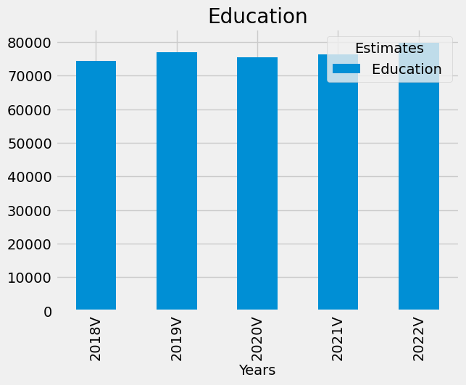
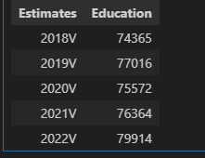
Closer look at education
During Covid we see a slight decrease
Not as much as i thought it did!

Slide 12
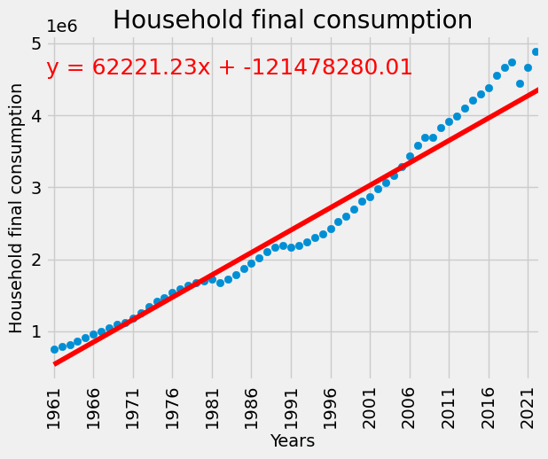
Regression-overall
R-Value of 0.8573
Clearly an upward trend
High R-Value = Meaning the years are correlated with expenses

Slide 13
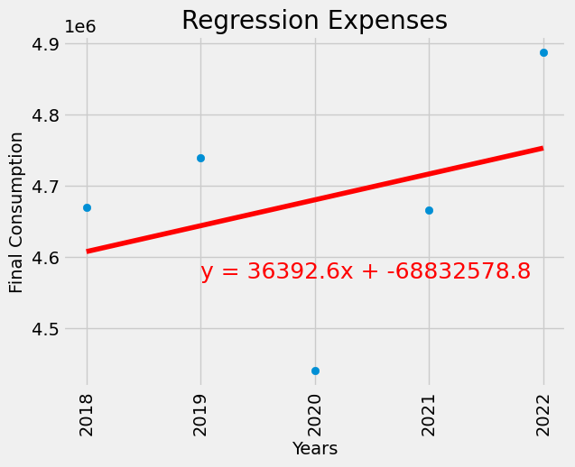
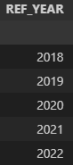
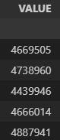
Regression-Covid
R-Value of 0.1265
During covid, household expenses decreased a lot
Compare to the trend before, which was upward trend with R-Value of 0.8573

Slide 14
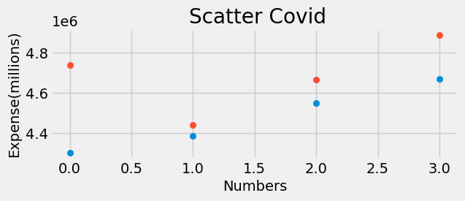
Scatter-Covid
Limitation: Covid happened too recent, hard to have large data set.
Hypothesis
- Null Hypothesis— Consumer spending habit stayed the same.
- Alternative Hypothesis– Consumer spending habit changed after covid.
P-Value = 0.147688
P-Value > 0.05
We have failed to reject the Null Hypothesis.

Slide 15

Olympics
How many countries in total have hosted the Olympics?
Out 19 countries, how many times did Canada host?
19
1976, 1988, 2010

Slide 16
How does Olympics affect the consumer spending?
By being selected to host the Olympic Games, it has been regarded by many as a major win.
Fans across the globe believe that hosting the Olympic Games can increase tourism which can boost local economies, and grow a host country's global trade and stature.
Is that really the case?

Slide 17
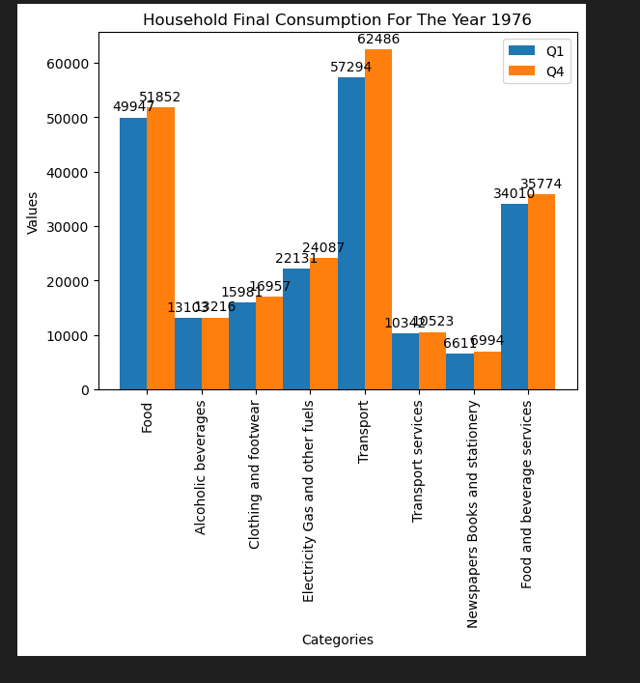
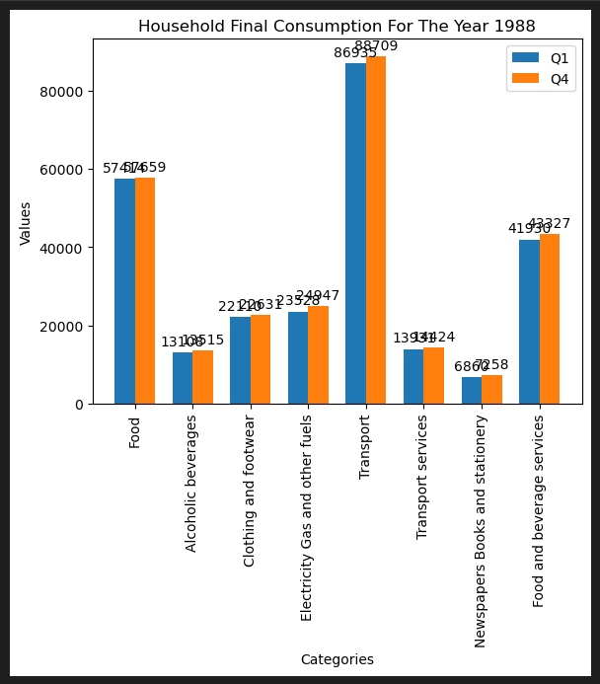
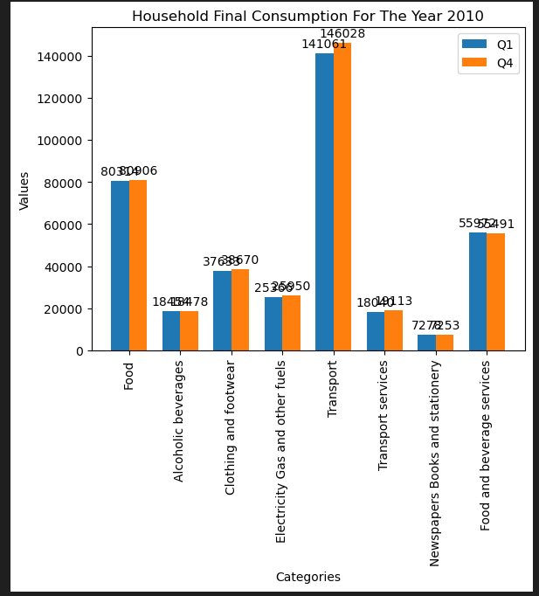
Pros #1 : The Olympics increase valuable tourism, which can boost local economies (1976)

Slide 18
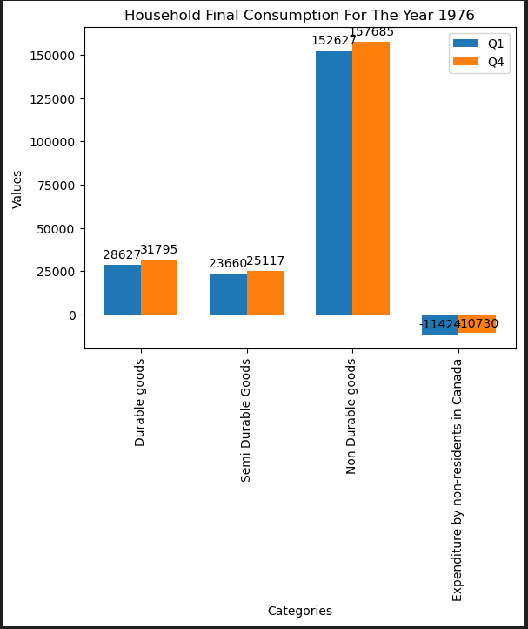
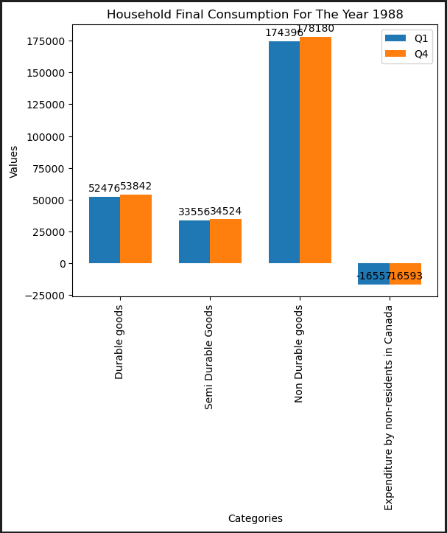
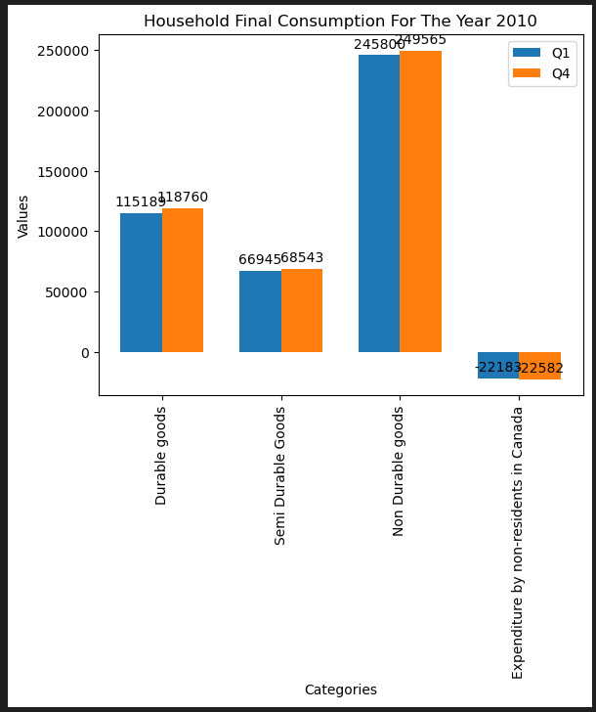
Pros#2: The Olympics increase a host country's global trade and stature

Slide 19
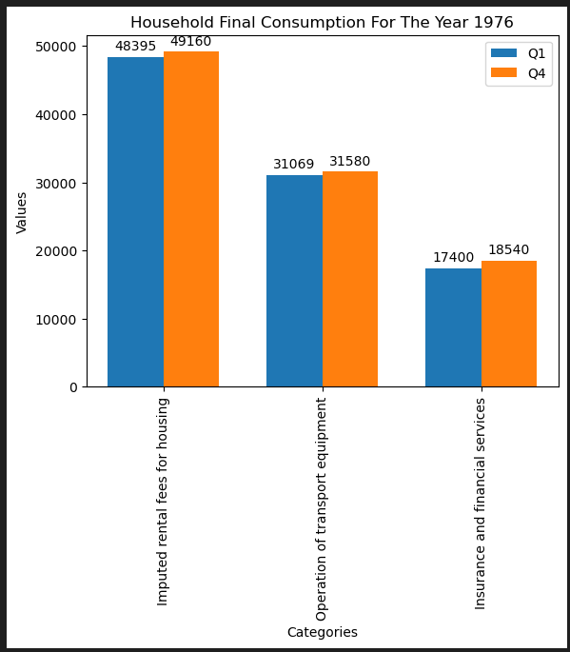
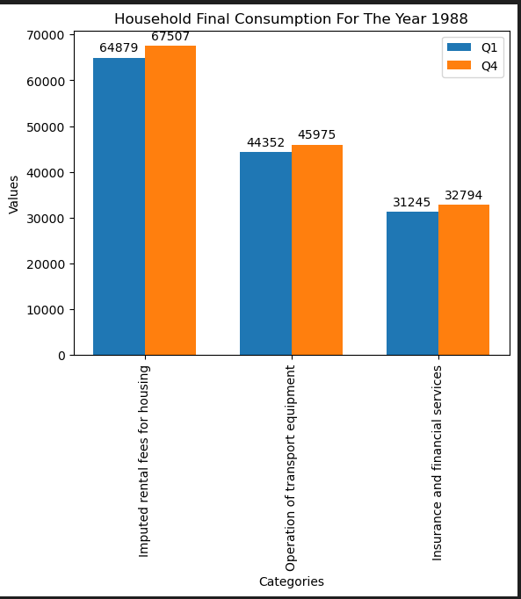
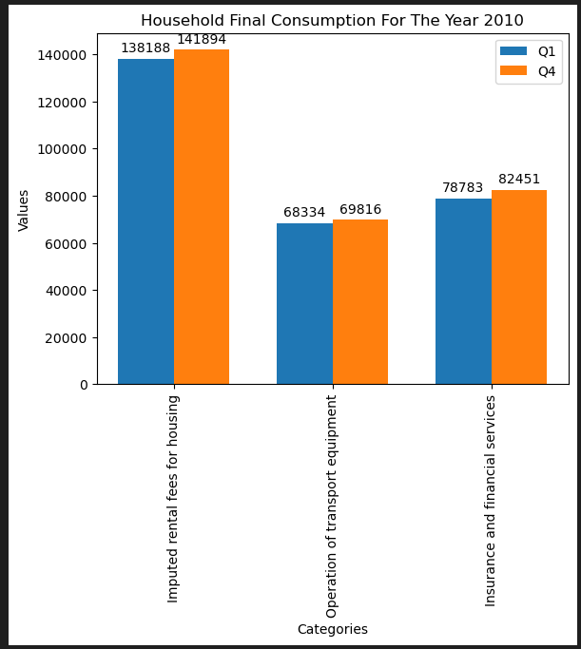
Cons#1: The Olympics are a financial drain on host countries

Slide 20
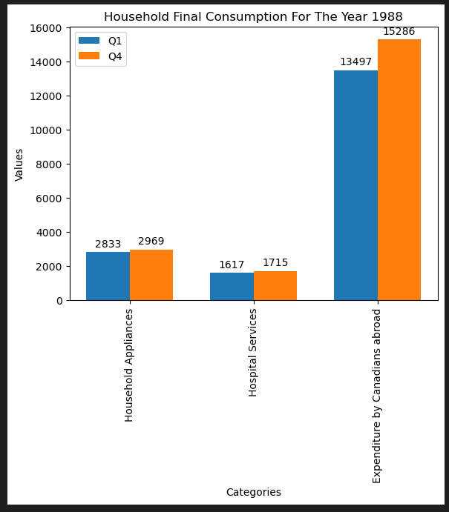
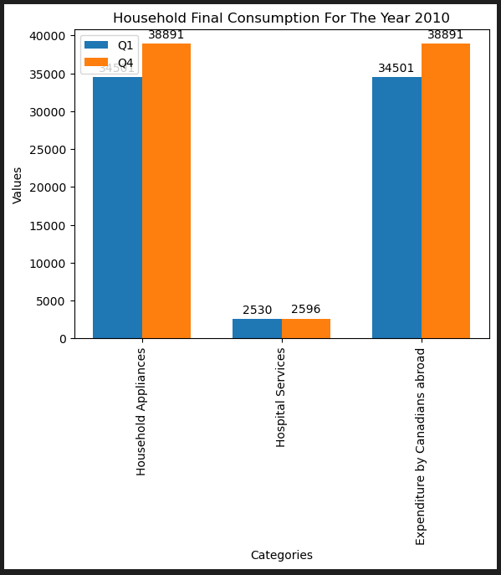
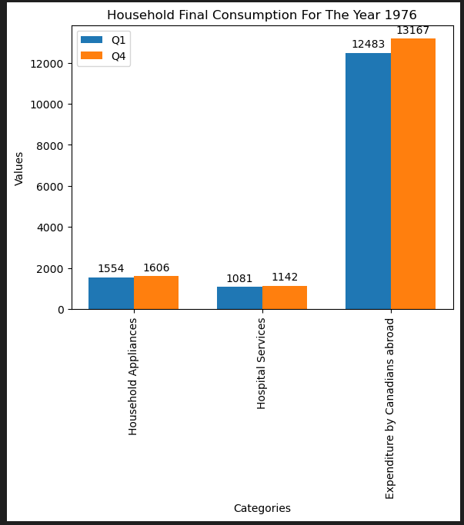
Cons#2: Displacement of local residents and disruption of communities

Slide 21
Is consumer spending affected by the Olympics?
(response to the hypothesis)
The impact of the Olympics on consumer spending will vary depending on factors, such as country's economic conditions, the scale of the event, and strategies which were implemented by local businesses and government.
While analysing the data, the Olympics did show the potential to be both beneficial but also destructive on consumer spending hence, it was hard to distinguish whether the hypothesis did stand or not.

Slide 22
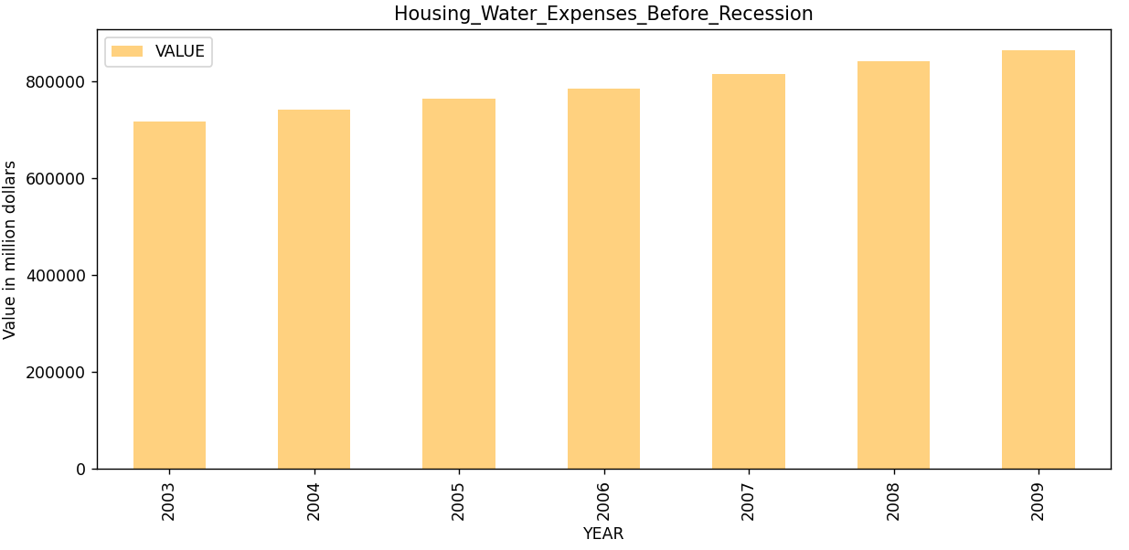
Expenses of Housing_Water and Electricity Before Recession
Housing,Water and Electricity expenses increase gradually before 5 years of Recession.
Recession Period was 07 to 09
720K million Dollars in 2003 and Increased up to 860K million Dollars by 2009

Slide 23
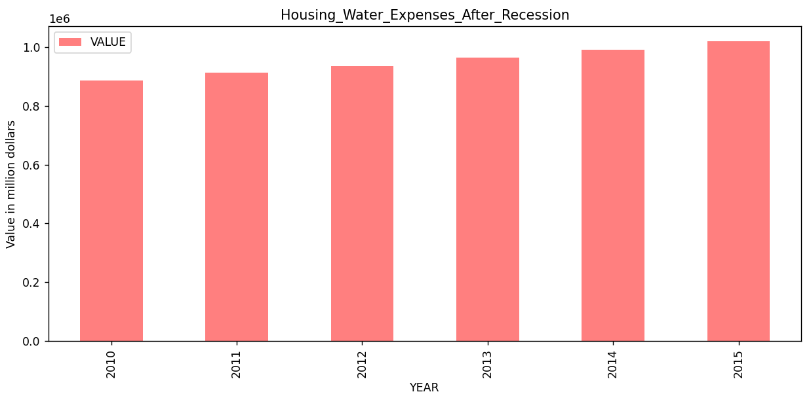
Expenses of Housing_Water and Electricity After Recession
After Recession again increased gradually
886K million Dollars in 2010 and Increased up to 1019K million Dollars by 2015
Expenses increased by 35.38% during 2003 to 2015.

Slide 24
Conclusion
The household expenditures in Canada generally rose from 1961 through the end of 2022, adjusted for inflation.
Many items are continuous growth from: Housing, water, electricity, gas and other fuels, insurance and financial services, and food and non- alcoholic beverage, ect.
Housing and Water expenses increased gradually over the years,Inflation doesn’t have much effect on spending.

Slide 25
Thank You!
Questions?

